Slide 1
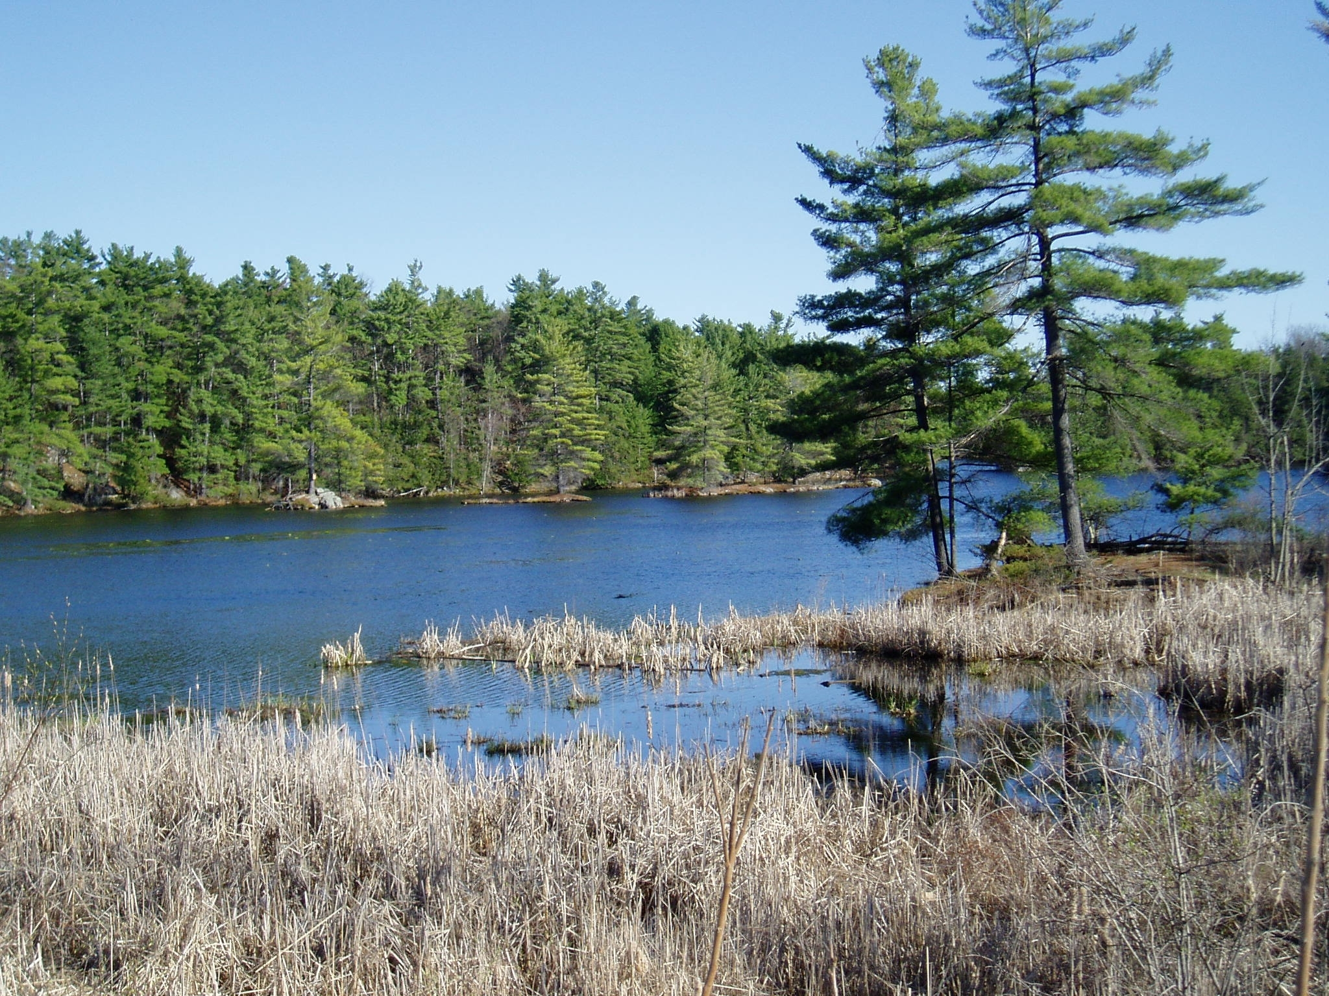
Harmful Algal Blooms
Due to the concern of health risks to humans and animals associated with algal blooms, all reports of potential algal blooms are a priority issue for this Ministry.
Any cyanobacterial bloom is regarded as being potentially toxic.
Eastern Region is the lead for the response procedure for reports of Harmful Algal Blooms (HABs) for the Province of Ontario.
Notes:
Pictures:
http://www.thescoop.ca/2020/01/phragmites-great-invasion.html
https://www.producer.com/news/unmonitored/

Slide 2
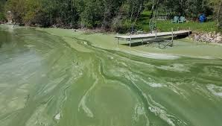
The frequency in the number of confirmed Harmful Algal Blooms is increasing.
The highest number of HABs occurred in 2020.
There were 90 confirmed blooms in the Province in 2021.
The majority are in our Northern Region followed by Eastern Region.
Notes:
Pictures:
http://www.thescoop.ca/2020/01/phragmites-great-invasion.html
https://www.producer.com/news/unmonitored/

Slide 3
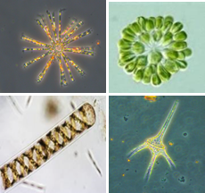
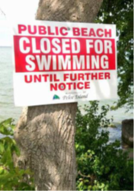
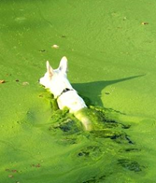
What are algal blooms
Algae are an essential component of a healthy aquatic food web. Blue-green algae has been in surface waters pre-humans
Excessive growth of algae under favorable environmental conditions can result in the formation of an algal "bloom"
When are algal blooms a cause for concern
Harmful Algal Blooms (HABs) are blue-green algae containing cyanotoxins, in sufficient concentrations, to cause bloom conditions.
Not all blue-green algae are toxin producing (cyanotoxins)
Cyanotoxins can cause skin and eye irritation and if ingested in large quantities can cause flu-like symptoms and are potentially toxic to humans, wildlife, livestock and pets

Slide 4
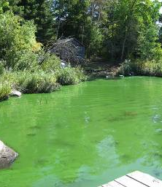
A “bloom” is defined as – “the excessive growth of one or more species of algae”
Conditions favourable for the formation of an algal bloom:
sufficient levels of nutrients in the water and sediments
calm weather
strong sunlight
high air & water temperatures
these conditions usually occur from mid summer to late fall
Blue-green algal blooms are usually relatively easy to identify visually – it has the appearance of florescent lime green paint on the water surface and smells like freshly cut grass

Slide 5
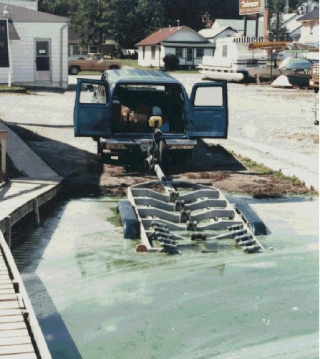
Aesthetic issues
blooms can produce unpleasant tastes & odours
decomposing algae can cause shoreline fouling
blooms may impact recreational activities & property values
Human health issues
algal toxins can impact humans (drinking water, skin)
toxins can also impact our pets, livestock, waterfowl & other animals
Drinking water & industrial water use issues
blooms can impact maintenance or treatment for water taking
taste & odour can affect public perception of drinking water safety
small systems with modest treatment facilities may not be able to effectively treat water during blooms

Slide 6
Factors influencing algal blooms
Phosphorus is the primary nutrient that promotes algal blooms in freshwater
Phosphorus
Occurs naturally on land and in all lakes and rivers and is essential for plant and animal life.
Inputs to lakes and rivers are increased by human activities.
TP comes from point (e.g., sewage treatment plants) and non-point sources (e.g., agricultural and urban stormwater run-off, faulty sewage systems, fertilizing lawns)
The link between phosphorus loads and levels in a lake is complex.
Agricultural Activities
Reducing excess phosphorus is a necessary step to improving the health of an over-enriched system, but it is not the only factor that influences algal bloom formation. Weather, geomorphic features such as depth and flushing rates also influence water quality.

Slide 7
Phosphorus and Upper Rideau Lake
The Total phosphorus concentration is used to interpret the nutrient status in Ontario lakes. Phosphorus is the element that controls the growth of algae in most Ontario lakes. Increases in phosphorus will decrease water clarity by stimulating algal growth.
Limnologists place lakes into three broad categories with respect to nutrient status.
Lakes with less that 10 µg/L TP are considered oligotrophic. These are dilute, unproductive lakes that rarely experience nuisance algal blooms (lake trout lakes such as Big Rideau Lake).
Lakes with TP between 10 and 20 µg/L are termed mesotrophic and are in the middle range with respect to trophic status. These lakes show a broad range of characteristics and can be clear and unproductive.
Lakes over 20 µg/L are classed as eutrophic and may exhibit persistent, nuisance algal blooms.
The average Total Phosphorus Concentration for Upper Rideau Lake in May (2012-2016) sampled at Narrow’s Locks was 17.58 ug/L. This places URL in the category at the higher end of the mesotrophic status.

Slide 8
Compliance is difficult and complicated when dealing with algal blooms (ie. often there is no direct pipe), the response to reports of HABs is about clear communication and following procedure.
Ensuring adherence to the Ministries Standard Operating Procedure ensures that all stakeholders are engaged throughout the process and risks are managed to ensure public health and safety.
The Ministry of Environment, Conservation and Park’s role is to gather, assess and provide basic scientific and technical information. Information is provided to Health Units in a timely fashion.
The Health Unit is responsible for making decisions as to whether notification of the public is required and what actions should be taken.
Notes:
Pictures:
http://www.thescoop.ca/2020/01/phragmites-great-invasion.html
https://www.producer.com/news/unmonitored/

Slide 9
Key role for MECP is to confirm if a HAB is present and obtaining a sample is the only way to confirm if toxins are present
Steps :
Report is received that a bloom is suspected
If it is determined a site visit is warranted, samples are collected and observations recorded.
Samples are sent to MECP’s LaSB for Algal Identification to confirm presence/absence of a bloom of algae with toxin potential, quick turn around 1-2 days
Sample then sent for ELISA screening for total toxins in the sample, quick turnaround to receive results, usually within 2-3 days
Samples then sent for concentrations of Microcystin variants e.g. microcystin-LR and Anatoxin-a
Each sample result is distributed to the HU and Complainant in a very timely manner
EMRB tracks HABs throughout the Province, an Algae Tracker App was developed allowing EO’s a quick snapshot of a history of blooms on a lake in Ontario
Notes:
Pictures:
http://www.thescoop.ca/2020/01/phragmites-great-invasion.html
https://www.producer.com/news/unmonitored/

Slide 10
Strategies to Minimize Impacts to the Lake
Minimize water use.
Do not use fertilizers or pesticides on lawns and gardens.
Maintain natural vegetation as ground cover or shrubs instead of a lawn. This will capture nutrient loadings to the lake and minimize runoff and erosion of shorelines.
Create areas that encourage infiltration (e.g. rain gardens, infiltration trenches (instead of gutters) grassed swales, vegetated filter strips
re-establish a minimum 3m wide, natural vegetative shoreline to buffer runoff to the lake that helps capture nutrient loadings and protect fish habitat and other species
Reduce lot grading and limit the creation of impervious surfaces towards the lake
Use phosphate-free, chlorine-free and biodegradable soap, shampoo, household cleaning products and detergents
Notes:
Pictures:
http://www.thescoop.ca/2020/01/phragmites-great-invasion.html
https://www.producer.com/news/unmonitored/

Slide 11
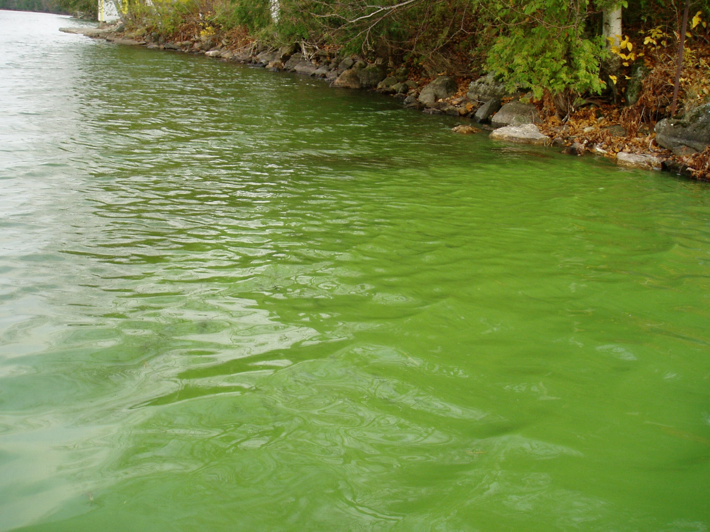
In the event of a suspected blue-green algal bloom, the public is advised to avoid using the water and report the incident to the Ministry’s Spills Action Centre
Call 1-800-268-6060
Notes:
Pictures:
http://www.thescoop.ca/2020/01/phragmites-great-invasion.html
https://www.producer.com/news/unmonitored/

