Slide 1
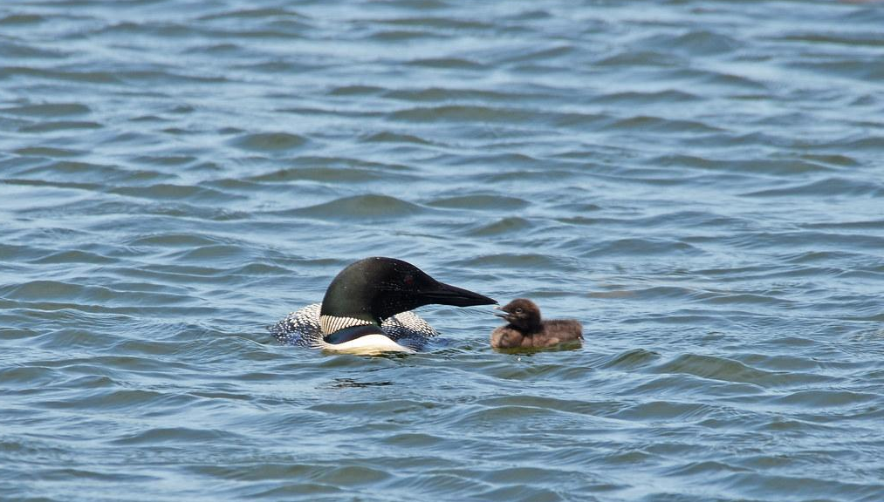
Lucky’s Adventures
Anne Huot
Oakweb Lane, Webster Bay
Charleston Lake
July 2021

Slide 2
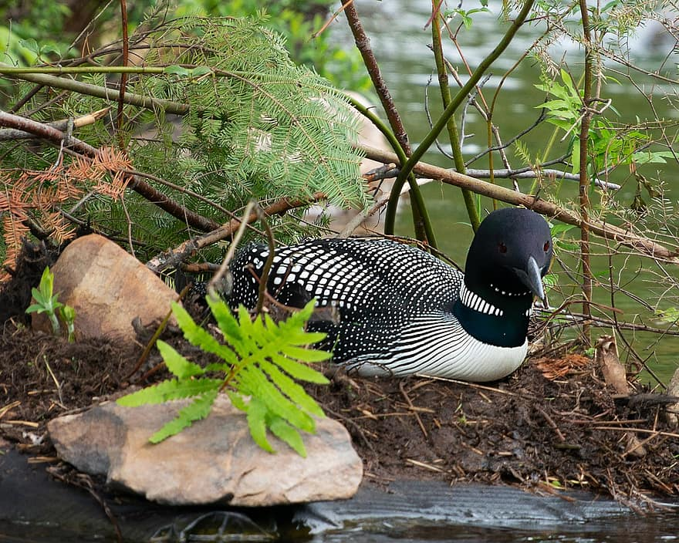
Hatched and ready to swim
Lucky’s parents were very happy when Lucky arrived safe and sound.
The nest was on Muskrat Island and nice people and the turtles protected the nest.
Lucky splashed and swam in Webster’s Bay on her first day !

Slide 3
Lucky’s First Adventure
Lucky was tired after swimming
She went to sleep on the island protected and excited .
The next day everyone woke up early .
But being a baby chick Lucky wanted to explore !
Her parents went into the water ready to teach Lucky how to dive for fish
But when they looked around Lucky was GONE !

Slide 4
Watchful Eyes
Lucky was Missing . Oh NO ! everyone on Oakweb Lane shouted !
Her parents made lots of noise with their beautiful voices to help Lucky find her way to safety. They searched everywhere for her.
Lucky was really hiding well.
Lucky where are you ?
But then a wise man named Dwayne bravely set out to the island to find Lucky. Did Dwayne find Lucky ?

Slide 5
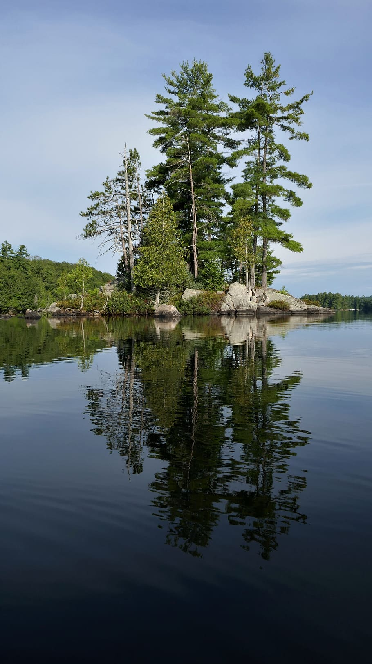
Lucky’s rescue
Muskrat Island was rugged Canadian Shield
There were rocks and trees and slippery slopes
There were water holes that were dark and scary
Lucky’s adventure landed her in one of these water holes.
She was scared and lonely and did not know how to get out.
She was only 2 days old !
But all of a sudden a hand reached down into the cold dark water and rescued Lucky.
It was Dwayne to the rescue !

Slide 6
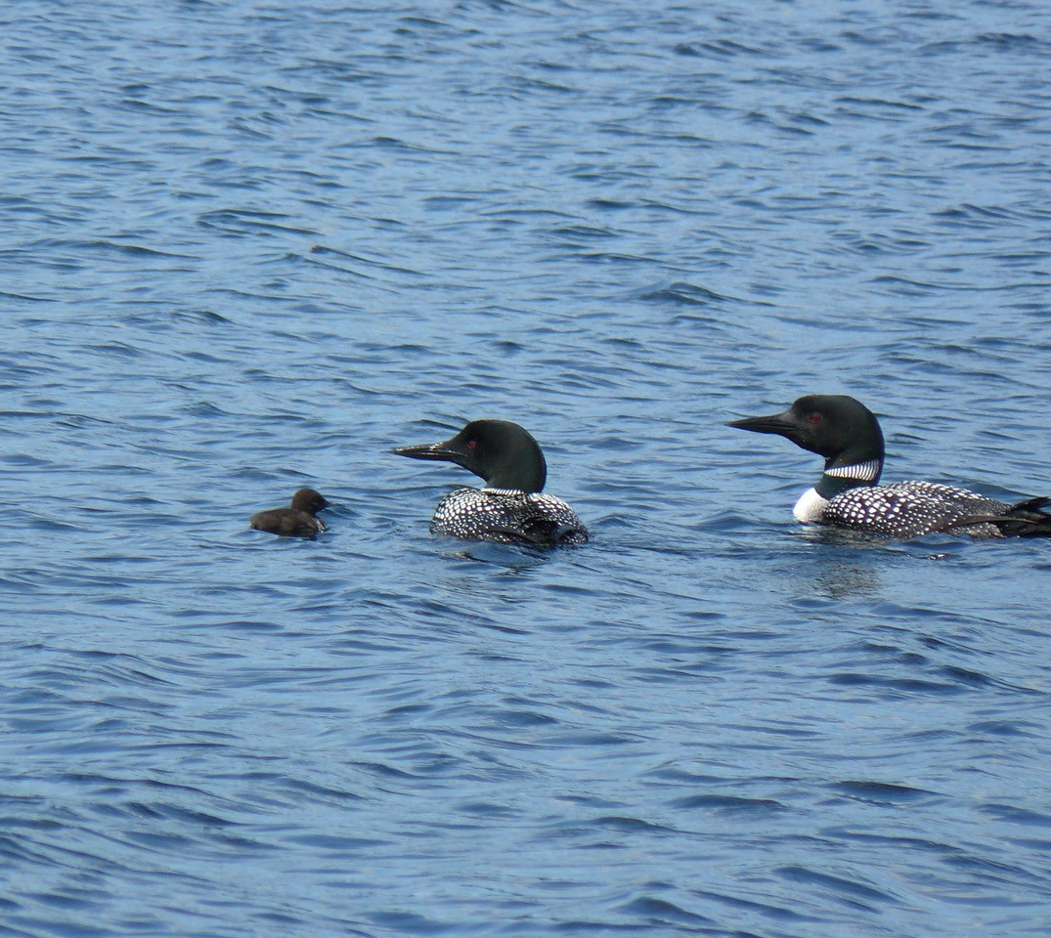
Safe and Sound at last !
Lucky was carefully placed in the lake by Dwayne.
Lucky was so thrilled she dove under the water for the first time.
She quickly came up and swam to her anxious parents.
The rest of the day she swam and dove among the big waves .
Lucky loved the lake as long as she could stay away from danger
Lucky was going to stay close to her parents for now .
At least until she was a little older !

Slide 7
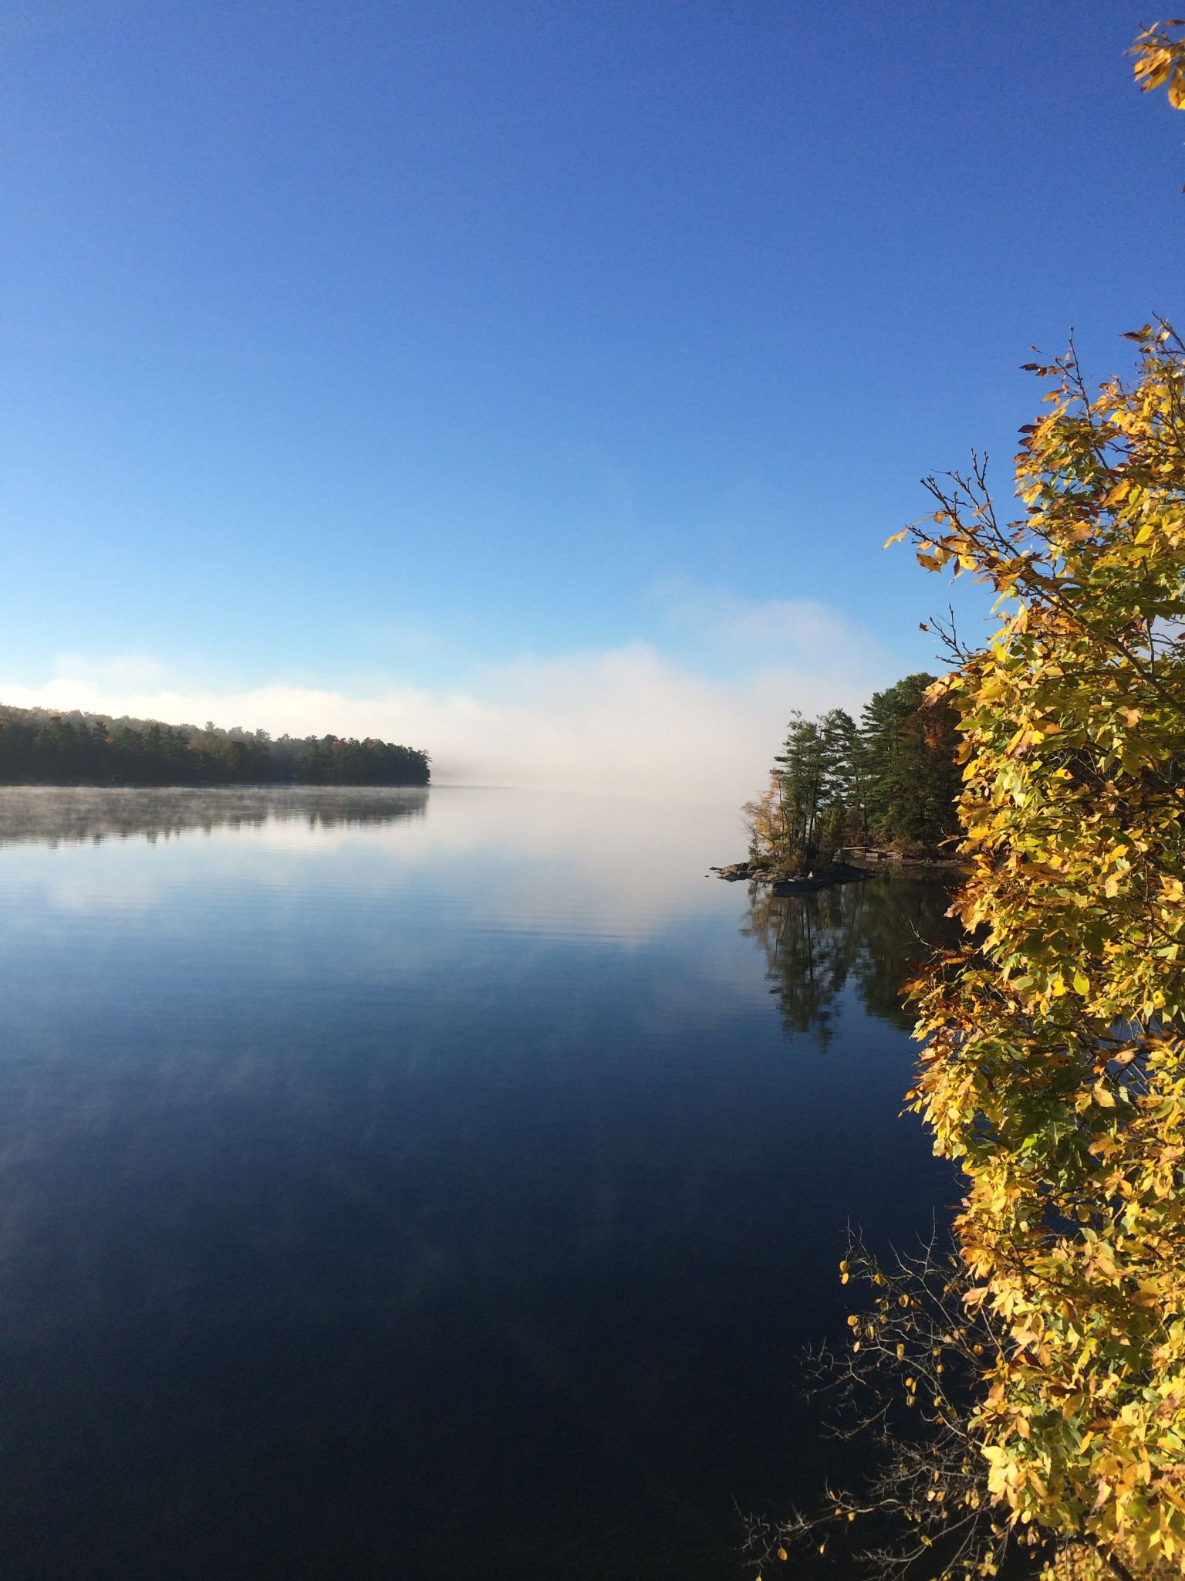
Oakweb Lane Celebrates !
Lucky was lucky ! So are Oakweb Lane cottagers !
Charleston Lake is so special.
Loons are an important part of the lake experience.
Not every lake has loon families.
Remember slow down near shorelines & near any loon families .
They count on us and we count on them.
Lucky will be singing and swimming and fishing for many years.
Say Hello when you see her !

